Slide 1

Primary Market
-
Rights Issue

Slide 2
Rights Issue – Overview
Offer of securities by a listed Company to those who are shareholders of the Company as on the record date fixed for the said Rights Issue.
Decision to have a Rights issue → Taken by the Board of Directors of the Company.
Existing shareholders as on a particular date (Record Date) are offered a right to subscribe to the Rights Issue using their Rights Entitlement
Shareholders also have the right to:
Renounce their Rights Entitlement (in full or part)
Apply for additional securities over and above what they are entitled to.
4

Slide 3
Types of Right Issue
Right issue based on payment terms
Issue of fully-paid right shares: the shareholders must pay the whole of the issue amount upfront at the time of allotment.
Issue of partly-paid right shares: where the entire issue amount is not demanded upfront. Instead, only a part of it is asked upfront, and the rest is paid in subsequent calls.
Right issue based on the transferability of rights
Issue of renounceable right share: the shareholders can sell their rights in the open market to other investors if they don’t wish to exercise their rights.
Issue of non-renounceable right shares: the option of transferability is not at the disposal of shareholders. Either they can subscribe to the shares, or the right will lapse post the record date.

Slide 4
Rights Issue – Key Terms
Record Date | Date announced by the Company. Date for determining the shareholders to whom the Rights Issue will be made and who would be eligible to participate in the Rights Issue. Disclosed to the Stock Exchanges. Provided on the Letter of Offer (LOF)/ Application Form.
Rights Entitlement (RE) and Ratio | Number of securities that a shareholder is entitled to in a Rights Issue. Typically in proportion to the number of equity shares held by the eligible shareholder on the Record Date; Disclosed to the Stock Exchanges. Provided on the LOF/ Application Form.
Renunciation of REs | Transfer of REs by an eligible shareholder, either on-market or off-market, to another person, whether an existing shareholder or not, in exchange of a consideration or otherwise; May be done to the full extent of the REs or for a part of the REs received by a shareholder.
6

Slide 5
Rights Issue – Key Terms
Renunciation Period | Period during which shareholders/ investors can renounce or transfer their Rights Entitlements; Disclosed in the Letter of Offer (LOF).
Rights Issue Price | Price to be paid by an applicant to subscribe to the securities offered through Rights Issue.
Issue Period | Minimum period of 07 days. May be extended to maximum of 30 days between Issue Opening Date and Issue Closing Date, inclusive of both days, during which applicants can submit their applications.
Promoter Subscription | Disclosure relating to the intention of the Promoter and Promoter Group to participate in the Rights Issue. Made in the section “Capital Structure” of the LOF.
ASBA | Application Supported by Blocked Amount. To make an application authorizing the Self Certified Syndicate Bank (SCSB) to block the application money in an ASBA account maintained with the SCSB.
7

Slide 6
Rights Issue – Key Documents
Draft Letter of Offer (DLOF) | Draft offer document Filed with SEBI for observations Includes issue related information and disclosures Made available on website of SEBI and Lead Managers
Letter of Offer (LOF) | Final offer document Includes the Issue Price, Rights Entitlement (RE) Ratio, Issue Period, Renunciation dates, other key terms of the Rights Issue, etc. Available on website of SEBI, Lead Managers, Registrar to the Issue, Company. Also Filed with the Stock Exchanges Copy may be requested from Lead Managers, Registrar or Company
Application Form (including online application form) | To make an application for allotment of securities in the Rights Issue Sent via e-mail / dispatched through registered post, speed post, courier at-least 3 days before issue opening Online application form provided by SCSB/ through Registrar's Web-based Application Platform (RWAP - on website of Registrar)
8

Slide 7
Rights Issue – Key Documents
Abridged Letter of Offer (ALOF) | Abridged version of the LOF Sent to the shareholders along with the Application Form Sent via e-mail/ dispatched through registered post / speed post / courier at-least 3 days before issue opening
Rights Entitlement Letter | A letter/ notification containing details of Rights Entitlement Sent to shareholders who are eligible for rights issue Contains details of number of equity shares held by the shareholder as on the Record Date, RE ratio, number of securities entitled to apply etc. Sent via e-mail/ dispatched through registered post / speed post / courier at-least 3 days before issue opening Also available on website of Registrar to the Issue
9

Slide 8
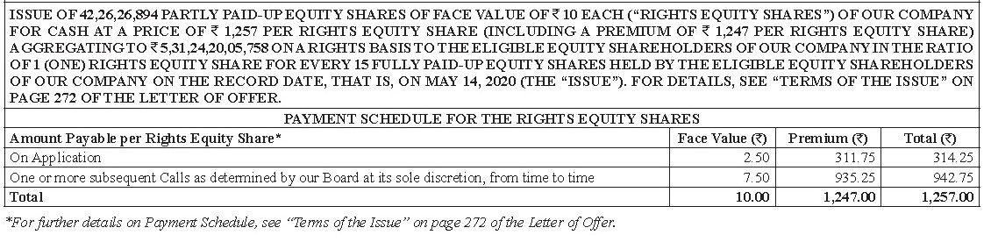
Sample Rights Issue Application Form (1/4)
Amount to be paid at time of application
Amount to be paid later
10

Slide 9
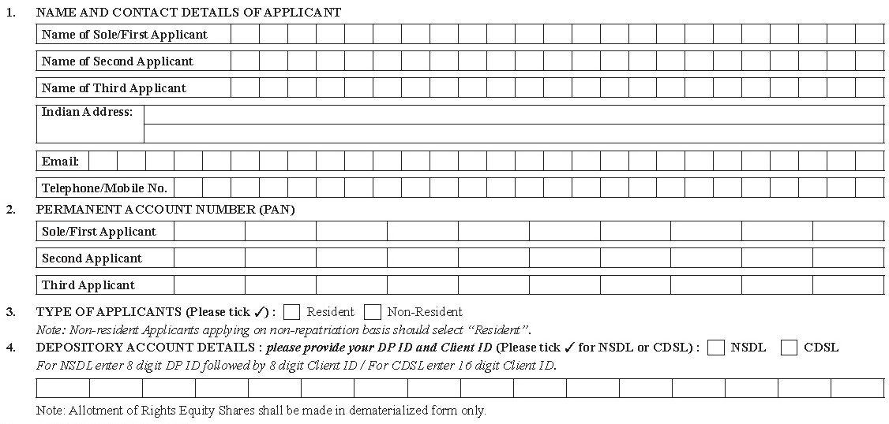
Sample Rights Issue Application Form (2/4)
→ To be filled by Applicant
11

Slide 10
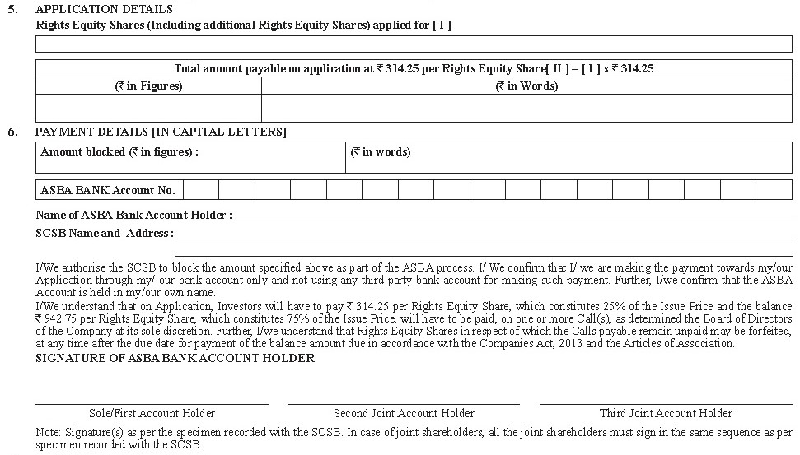
Sample Rights Issue Application Form (3/4)
12

Slide 11
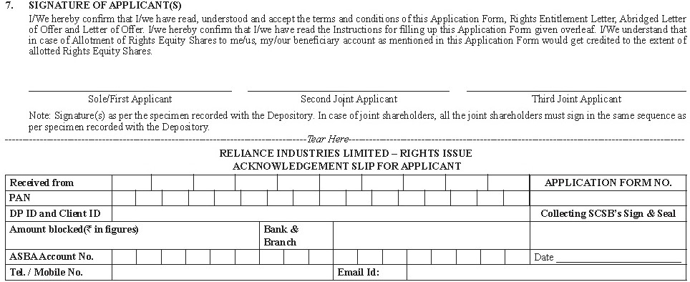
Sample Rights Issue Application Form (4/4)
→ Declarations on Source of funds and Future payments
→ Signature must match with specimen signatures provided
→ To be filled by Bank (SCSB)
13

Slide 12
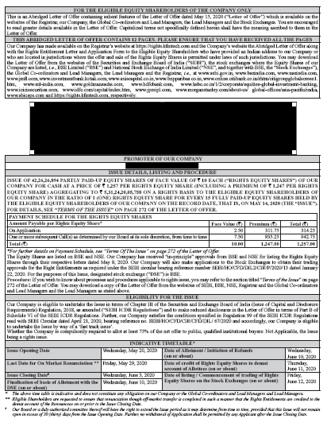
Sample Abridged Letter of Offer (ALOF)
14

Slide 13
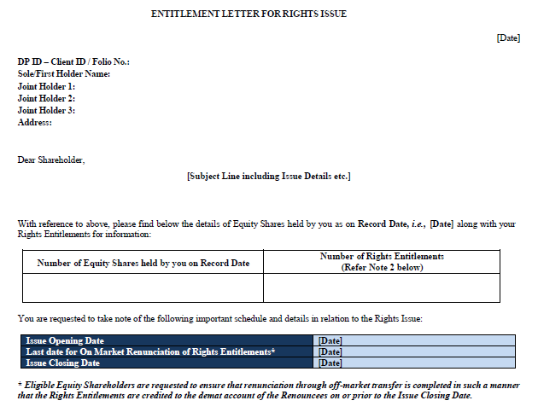
Sample Rights Entitlement Letter
15

Slide 14
Electronic Rights Entitlements (REs)
Credit of Rights Entitlements (REs) | A separate ISIN is created for REs. Demat form only. REs credited to the demat account of the shareholders as on Record Date, before the issue opening date. May be credited to demat suspense escrow account in certain cases such as shares held in physical form, shares under litigation, frozen demat account, details of demat account not available, etc.
How to check your REs? | Rights Entitlement Letter sent to the shareholders. On the website of Registrar (by keying in details like Folio Number/ DP ID-Client ID, PAN, etc.). Receipt of credit message from NSDL/ CDSL on credit of REs. Demat statement from depository participant showing credit of REs.
16

Slide 15
What to do with Rights Entitlements? – Options available
Apply to full extent of Rights Entitlement
Apply for a part of the Rights Entitlement (without renouncing the other part)
Apply for a part of the Rights Entitlement and renounce the other part of the Rights Entitlement
Apply for the full extent of the Rights Entitlement and apply for additional Rights securities *
Renounce the Rights Entitlement in full
*Shares will be allotted if the Rights Issue is under-subscribed
FAQs on Rights Entitlements
SEBI FAQs
BSE FAQs
NSE FAQs
Price paid to purchase REs on market is not connected to amount paid in Rights issue subscription! They are independent of each other.
17

Slide 16
Trading in Electronic Rights Entitlements
How to trade in Rights Entitlements?
On-Market
Off-Market
Buy/ sell on the floor of the Stock Exchanges through a Stock Broker
Buy/ sell using Delivery Instruction Slips (DIS)
T + 2 settlement (T refers to the date of trading)
Trade for trade (No short selling allowed)
Trading commences along with the opening of the Issue
Closes 4 working days prior to the closure of the Issue
Trading in normal market hours
Trade to be effected off-market between buyer and seller
Off-market transfer to be completed in such a manner that the REs are credited to the demat account of the Renouncees on or prior to the Issue Closing Date
REs which are neither renounced nor subscribed, on or before the Issue Closing Date will lapse and shall be extinguished after the Issue Closing Date.
18

Slide 17
Overview of Rights Issue Application Process
How to Apply in a Rights Issue?
Apply Through ASBA
Apply Through Registrar’s Web based Portal (R-WAP)*
Application money remains in Applicant’s bank account till allotment
List of SCSBs available at: https://www.sebi.gov.in/sebiweb/other/OtherAction.do?doRecognisedFpi=yes&intmId=34
Application money gets debited from Applicant’s bank account
Please note that the R-WAP procedure may vary; Investors are requested to check the LOF and Application Form of the relevant Rights Issue
Physical ASBA
Online ASBA
Special online application facility created by the Registrar to the Issue
Applicants to Log into Registrar’s web based portal (details will be available in LOF and Application Form)
Submit online form using R-WAP and make payment through net banking or UPI (as applicable)
Online acknowledgment upon successful completion
May only be available for Resident Investors (check LOF/ Application Form doe further details)
Application Form to be printed, filled-in and submitted to the Designated Branches of the SCSBs
Applicants can also submit a Plain Paper Application to the Designated Branches of the SCSB
Online/ electronic application through using the website of the SCSBs (if made available by such SCSB)
Check with your SCSB if it offers an online facility for making application in a Rights Issue
*Currently available only for Rights Issues opening on or before December 31, 2020
Investors can make payment only using bank account held in their own name - Third-party payments would not be accepted
An application cannot be made by cash/ cheque
19

Slide 18
Participation in Rights Issue by Shareholders holding Physical Shares
Credit of REs for Physical Shareholders
Credited to a separate Escrow Demat Account before the opening of the issue
Option 1
Option 2*
Physical Shareholder can open a demat account before 2 Working Days prior to issue closing date
Additional facility for Physical Shareholders who cannot open a demat account before to 2 Working Days prior to Issue Closing Date
Furnish the relevant details* to the Company or Registrar no later than 2 Working Days prior to issue closing date
Application can be made through R-WAP specifying the folio no. and other details during the issue period
(Physical Shareholders will be ineligible to renounce REs)
REs transferred to the demat account latest by 1 Working Day prior to issue closing date
Allotted securities will be kept in a suspense demat account maintained by the Company
Application can be made on or prior to the issue closing date – Application will be considered only if REs are in the demat account furnished
Post Allotment
Physical Shareholder to Open demat account
Audit
Submit relevant details* to Company or Registrar in specified timeframe
Audit
Get credit of Rights securities in the demat account
*Currently available only for Rights Issues opening on or before December 31, 2020
* Name(s), Indian address, email address, contact details and details of demat account along with copy of self attested PAN and self-attested client master sheet
20

Slide 19
Plain Paper Application
Option to make an application on Plain Paper.
Application to be submitted to SCSB before issue closing, for blocking of application money in Applicant’s bank account with the said SCSB.
REs cannot be renounced.
Details to be provided in Plain Paper Application:
Name of Issuer Company
Name and address of shareholder including joint holders (in same order & as per specimen recorded with issuer/ depository)
Registered Folio No./ DP and Client ID No
No. of shares held as on Record Date and allotment option selected (only demat form)
No. of rights securities entitled to and applied for within entitlement;
21

Slide 20
Plain Paper Application
No. of additional rights securities applied for, if any;
Total no. of rights securities applied
Details of the ASBA Bank Account and authority to SCSB to block equivalent amount
In case of NRI shareholders making application with Indian address, details of NRE/ FCNR/ NRO Account maintained with the SCSB
PAN of shareholder (including each joint holder), except for applications on behalf of the Central or State Government, the residents of Sikkim and the officials appointed by the courts
Signature of the shareholder (in case of joint holders, to appear in the same sequence and order as they appear in the records of the SCSB)
Copies of any approvals required to make application
One of the risks of making an application on Plain paper is that application may get delayed / lost in transit.
22

Slide 21
Application through ASBA Mechanism
Application through ASBA
(can be made through Online or Physical process)
Physical ASBA
Online ASBA
Print the Application Form/ use Plain Paper Application;
Fill-in the necessary details including ASBA Bank Account details
Check with your SCSB if it offers an online facility for making application in a Rights Issue
Login to the banking website of the SCSB
Submit the Application Form at designated branch of SCSB*
Open the application page and fill-in the necessary details and submit the bid;
Online Acknowledgement is generated
Obtain acknowledgment slip from the SCSB
SCSB submits bid to Stock Exchange and blocks ASBA Bank Account
SCSB submits bid to Stock Exchange and blocks ASBA Bank Account
The list of banks and branch details for the ASBA process is provided on the website of SEBI at https://www.sebi.gov.in/sebiweb/other/OtherAction.do?doRecognisedFpi=yes&intmId=34/
23

Slide 22
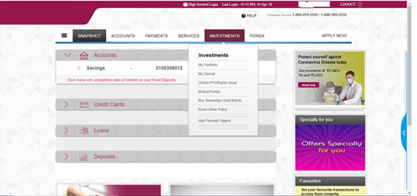
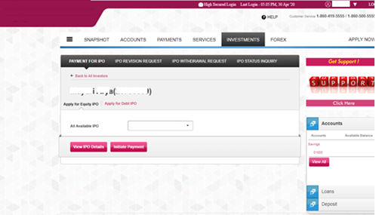
Illustration of Online ASBA: Application through Internet Banking (1/2)
Login, go to Investment Tab and select Rights Issue and Click on Apply for Rights Issue in the next screen
Select relevant Issuer and Initiate Payment
22
Illustration only. Please contact your SCSB for the details on online ASBA facility for Rights Issue, if any, provided by it.
24

Slide 23
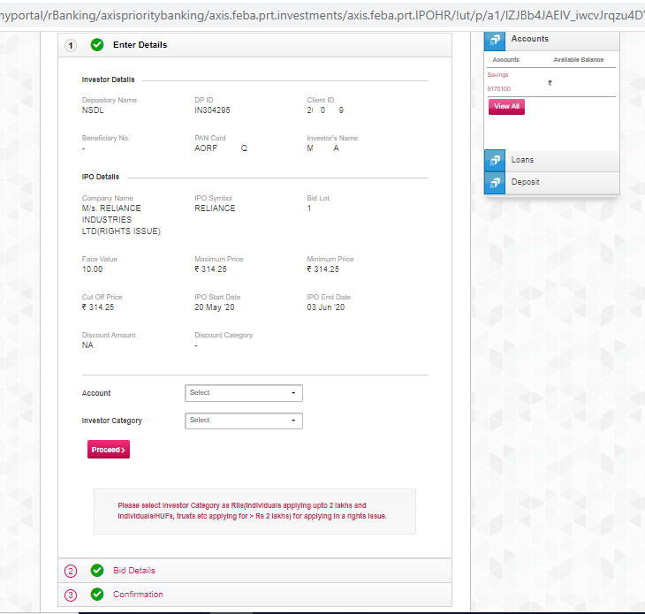
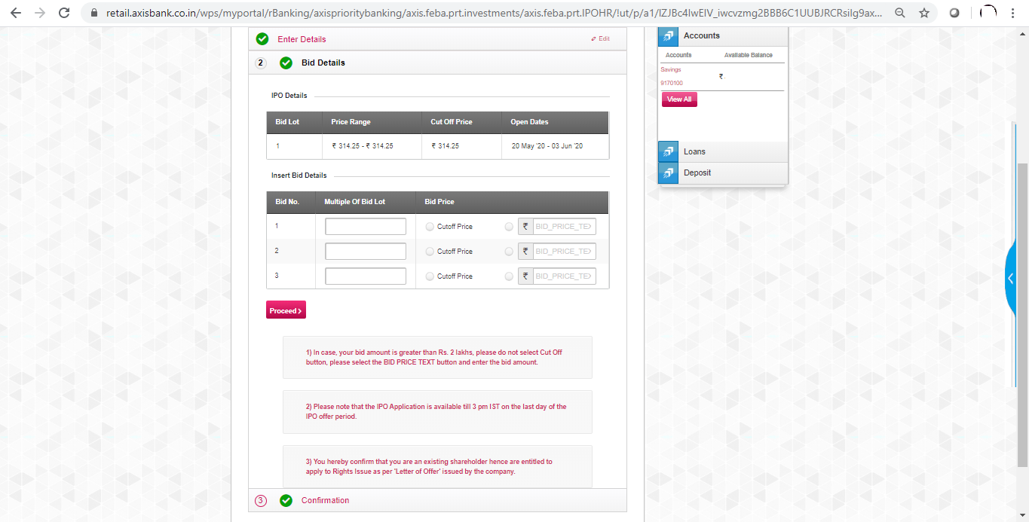
Illustration of Online ASBA: Application through Internet Banking (2/2)
Read the Instructions, fill in necessary details
Click proceed to submit the bid. Thereafter, confirm details and complete the application
23
25

Slide 24
Rights Issue Application through R-WAP
Visit Registrar’s Web based portal and go to R-WAP -> Apply for Rights Issue
Confirm details and complete necessary verification procedures (including through OTPs)
Select payment option (Through Internet banking/ UPI) and proceed for payment
Complete payment
Generate reference number for application
Please note that the R-WAP procedure may vary;
Investors are requested to check with LOF and Application Form for their Rights Issue
26

Slide 25
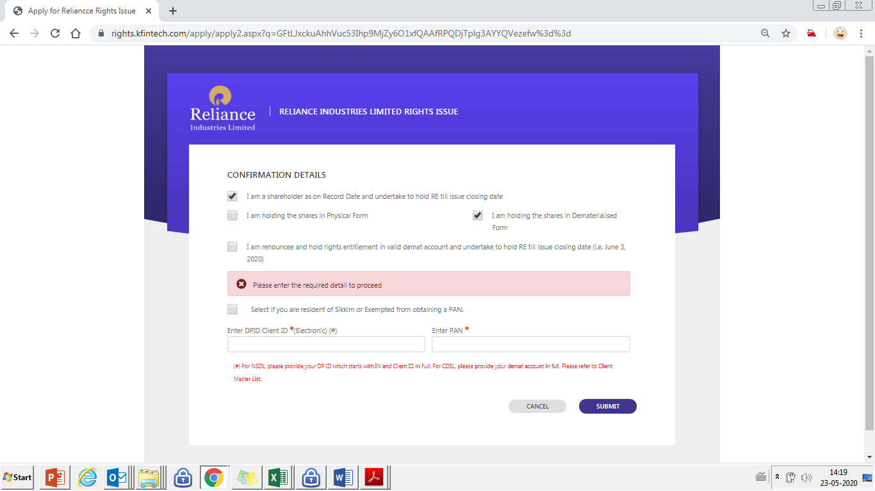
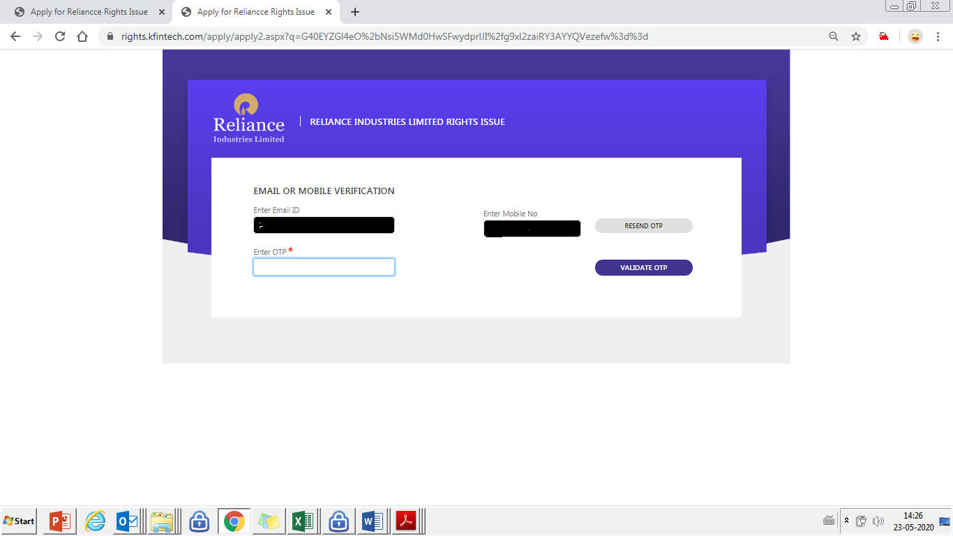
Applying through R-WAP: Confirm Details and Verification
Enter DP ID-Client ID, and PAN
Enter Email address and mobile number and generate OTP
Enter OTP and complete verification
25
27

Slide 26
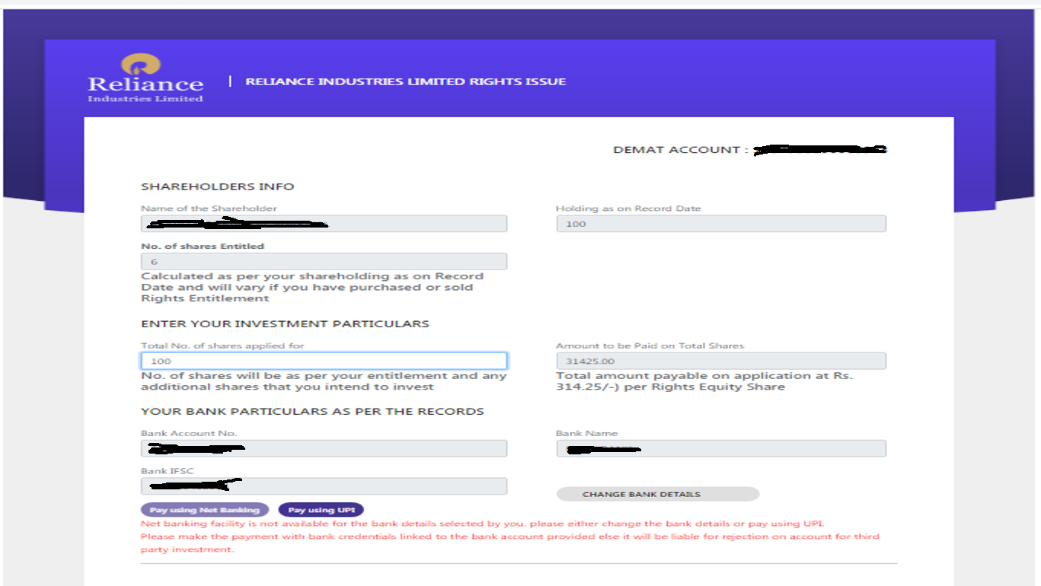
Applying through R-WAP: Application
Fill in the necessary details in the required fields
No of shares to apply
Bank Details – Net Banking or UPI
26
28

Slide 27
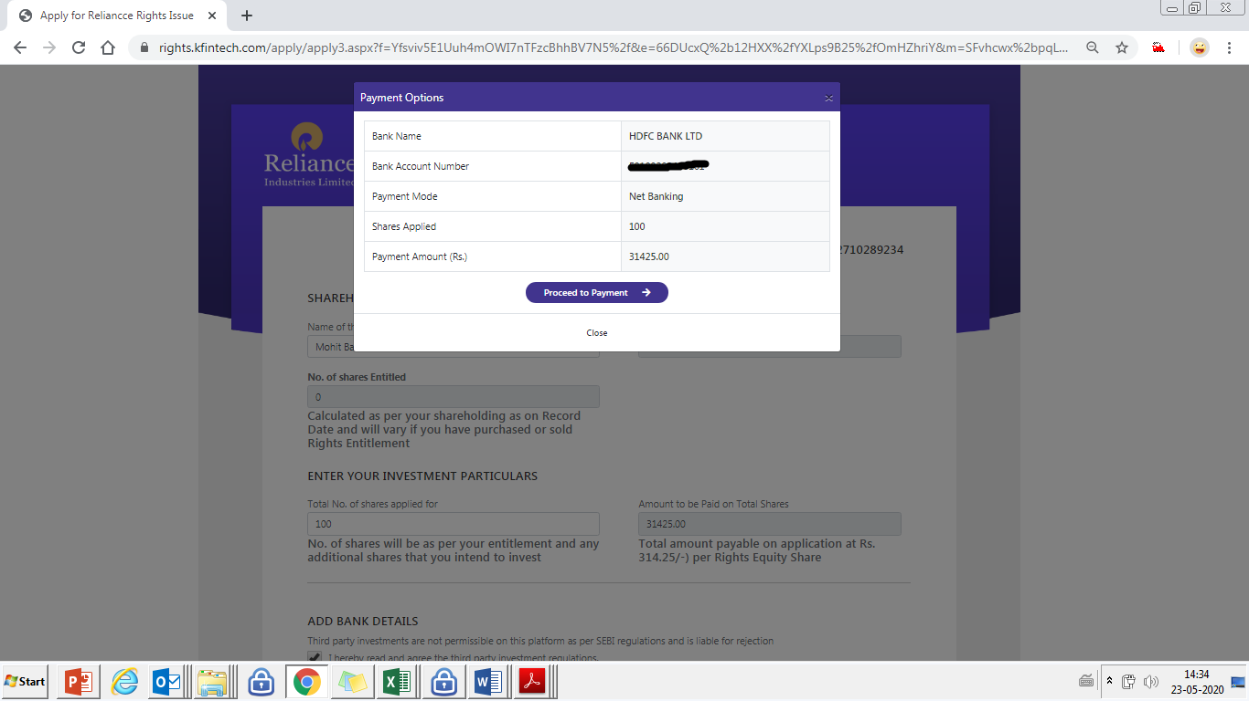
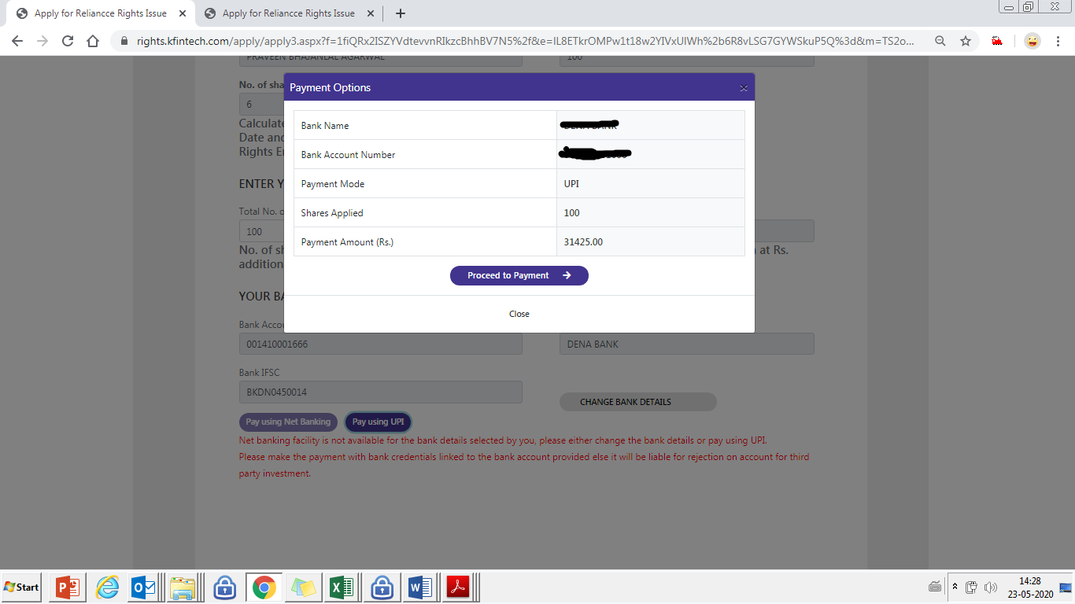
Application through R-WAP Payment
Click on “Proceed to payment”,
You will be taken on your bank page/ UPI Application to make payment
Once payment is completed, a reference no for your application will be generated
If you choose to pay through UPI, necessary bank account details need to be entered
Click on “Proceed to payment”,
You will be taken on your bank page/ UPI Application to make payment
Once payment is completed, a reference no for your application will be generated
29

Slide 28
Checking Allotment Status and Grievance Mechanism
Status of allotment/ refund related to Rights Issue application →
informed to investors by SMS/email/ letter.
May be checked by visiting “Investor Services” section on the website of the Registrar for the Issue (RTA).
Issue with regard to Non-allotment of shares / Refund etc. →
Contact RTA immediately.
Non-Satisfactory Resolution by RTA -> File a complaint against RTA with SEBI on:
SEBI SCORES website/ Mobile App (on Android and iOS platform)
30

Slide 29
Checking Allotment Status and Grievance Mechanism
Contact Details of RTA:
Provided in Letter of Offer of Rights Issue
Available on SEBI Website at:
https://www.sebi.gov.in/sebiweb/other/OtherAction.do?doRecognisedFpi=yes&intmId=10
Non-Satisfactory Resolution by RTA -> File a complaint against RTA with SEBI on:
SEBI SCORES website/ Mobile App (on Android and iOS platform)
31

Slide 30
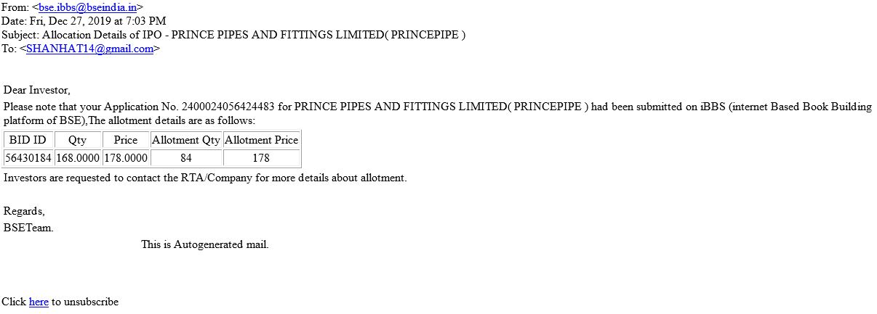
Illustration for Allotment Status (Email)
Promoter can subscribe to entire lot of shares.
No minimum subscription.
32

Slide 31
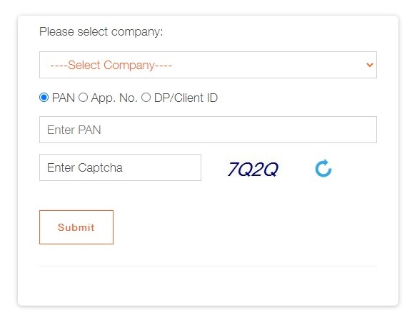
Illustration for Allotment Status (RTA Website)
33

Slide 32
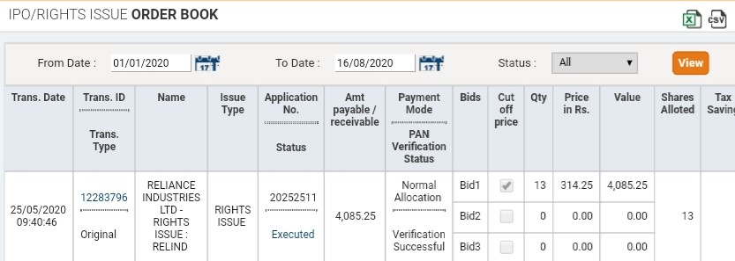
Illustration for Allotment Status (Bank/ Stock Broker Website)
34

Slide 33
Thank You
35

